Slide 1

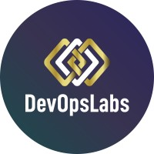
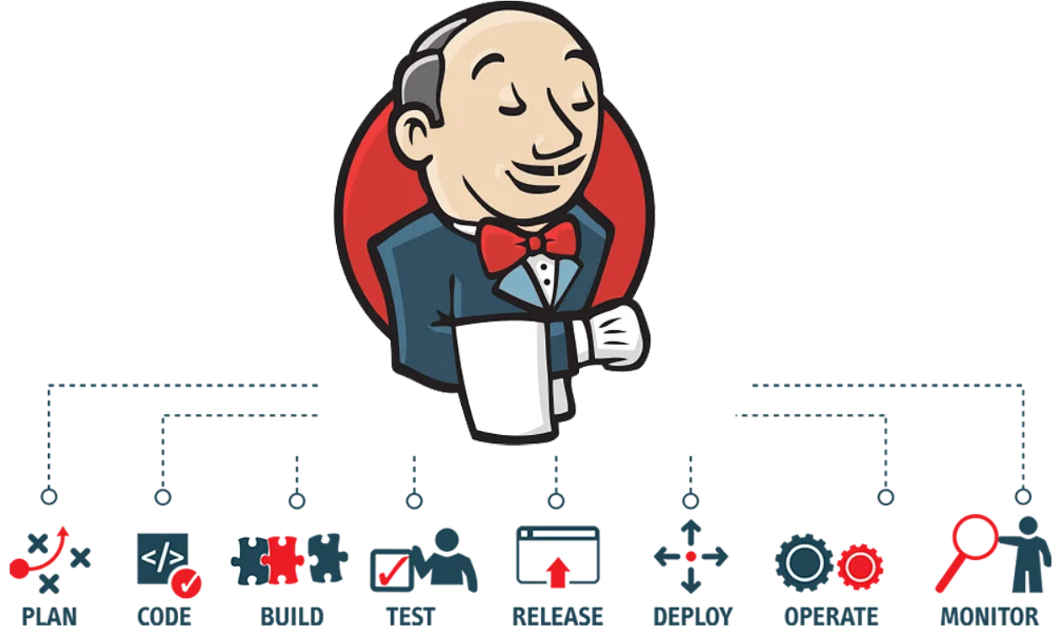
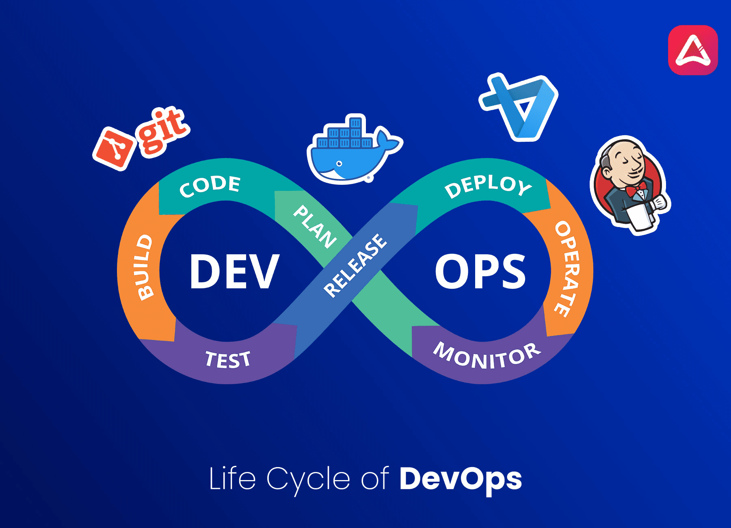

Expectation Setting Overview
1
Subject: Devops Lab
Subject Code: BCSL657D
Semester : V
Course Instructor: Prof. Vijaysanthi/Prof. Nidhi Joshi Parsai/ Prof. Jhanvi/Prof. Neeraj/Prof. Bindhya
Notes:
1

Slide 2
Agenda
2
Day-01
Introduction
Student perspective
Introduction to subject
Why subject is important
Real World Applications
Course Objectives
Pre-requisites
Course Outcomes
CO-PO mapping
Quiz
Day-02
Textbooks and Reference books
Lesson Plan
Assessment Plan
Expected classroom behavior
Some useful links

Slide 3

What is Cloud?
3
The cloud is a metaphor for a global network of remote servers a single ecosystem, commonly associated with the Internet.

Slide 4
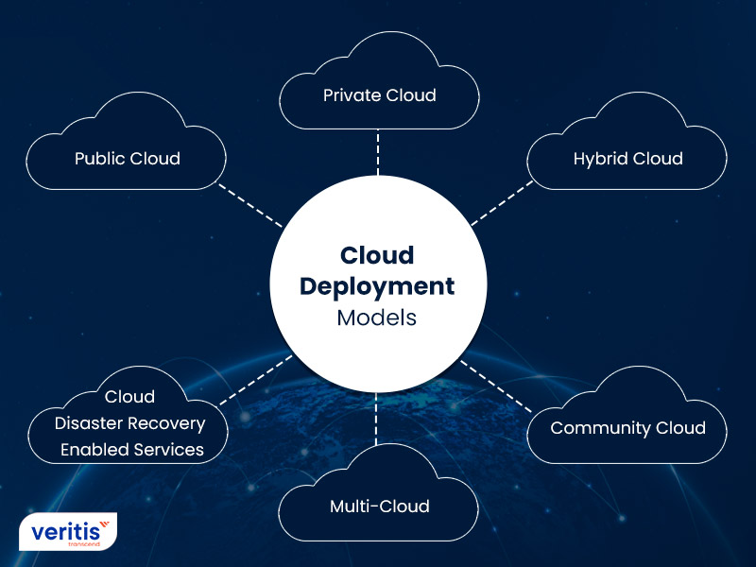
Types of Clouds
4
Public Cloud
Private Cloud
Hybrid Cloud
Community Cloud
Multi-Cloud

Slide 5
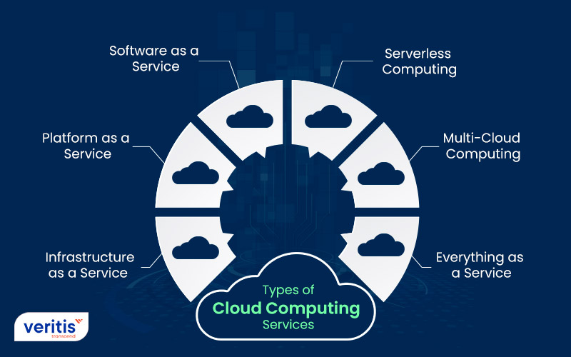
Types of Cloud Computing Services
5
SaaS
PaaS
IaaS
Serverless Computing
Multi-Cloud Computing
XaaS

Slide 6
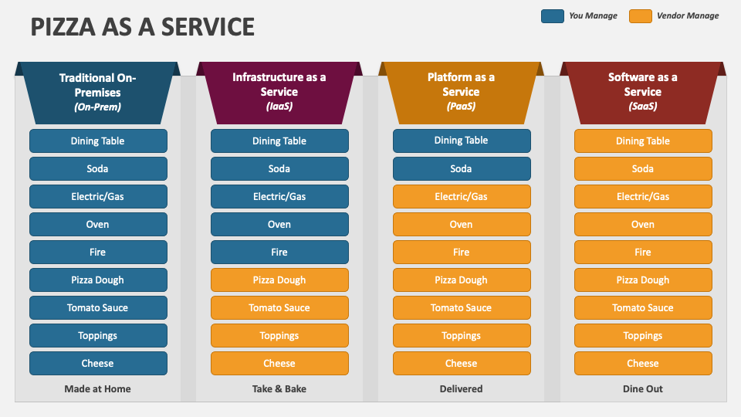
Example: Pizza as a Service to better understand
6

Slide 7
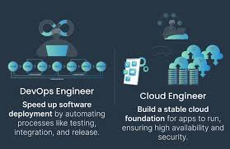
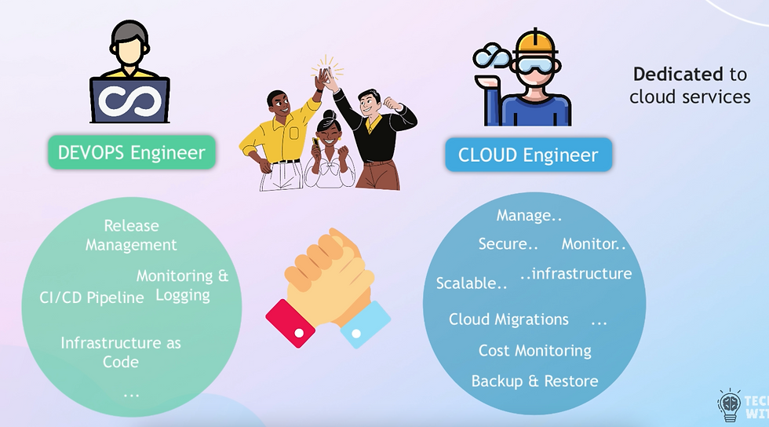
WHO ARE CLOUD ENGINNERS & WHO ARE DEVOPS ENGINEERS??

Slide 8
MAJOR KEY DIFFERENCE
THE MAIN DIFFERENCE BETWEEN A DEVOPS ENGINEER AND A CLOUD ENGINEER IS THEIR FOCUS: DevOps engineers focus on the software development process, while cloud engineers focus on the cloud infrastructure

Slide 9
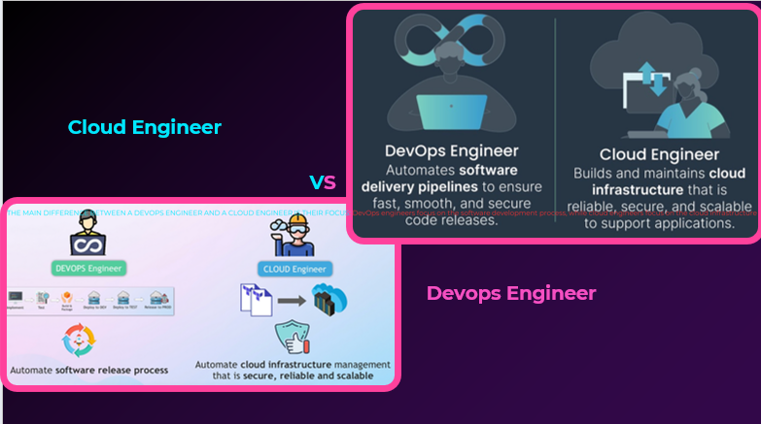

Slide 10
What is DevOps?
10
DevOps is a culture which promotes collaboration between Development and Operations
Team to deploy code to production faster in an automated & repeatable way.
The word 'DevOps' is a combination of two words 'development' and 'operations.'

Slide 11
What is DevOps?
11
DevOps in simple words 👇
DevOps means working together.
It’s a way where developers (who write code) and operations teams (who run and maintain systems) work as one team.
👉 Goal: build software faster, test it better, and deploy it smoothly.
Example:
Instead of writing code first and fixing problems later, DevOps helps teams automate testing, deployment, and monitoring so updates reach users quickly and safely.
In one line:
DevOps = Develop + Operate together for faster and reliable software.

Slide 12
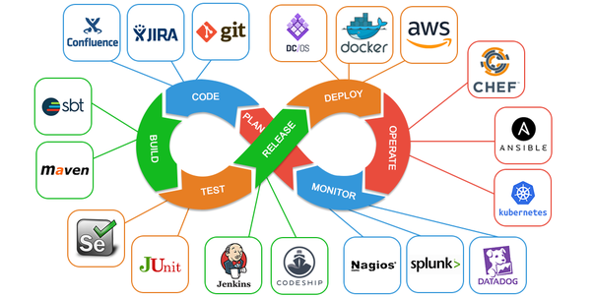
DevOps Lifecycle
12

Slide 13
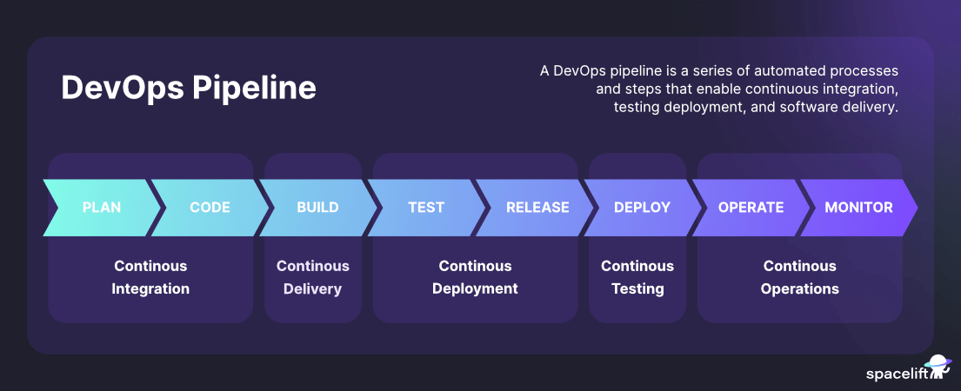
STAGES OF DEVOPS
13

Slide 14
What's in it for you?
14
Collaboration and trust
Release faster and work smarter
Accelerate time to resolution
Better manage unplanned work

Slide 15
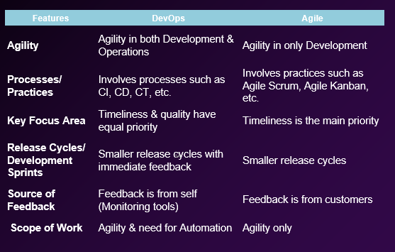
DevOps Vs Agile
15

Slide 16
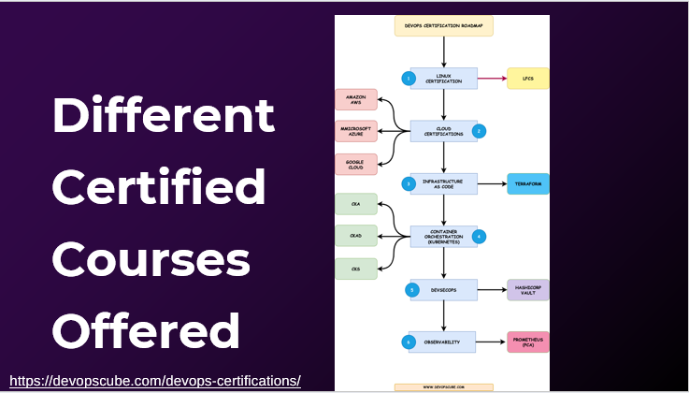
16

Slide 17
Percentage of Job Roles related to Devops accross Globe
17
NEARLY 70% OF
Techies work relates to the stream of devops

Slide 18
Most Demanding Roles in India
18
1. Cloud Security Analyst
2. Cloud Engineer
3. Cloud Administrator
4. Devops Engineer
5. Devops Administrator
6. DevSecOps Engineer

Slide 19
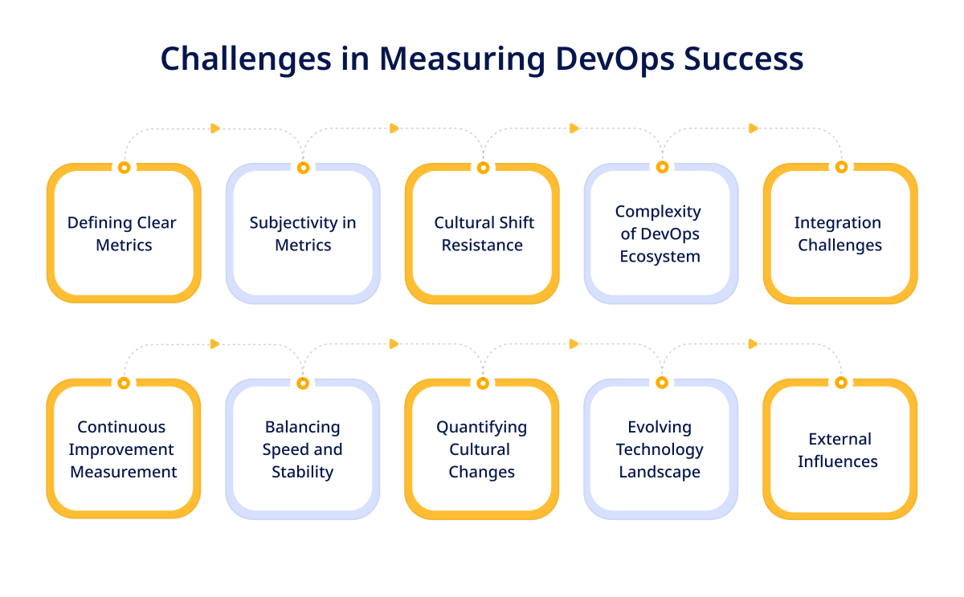
MEASURING YOUR SUCCESS IF OPTING DEVOPS AS YOUR CAREER
19

Slide 20
Experiments
20
1 Introduction to Maven and Gradle: Overview of Build Automation Tools, Key Differences Between Maven and Gradle, Installation and Setup
2 Working with Maven: Creating a Maven Project, Understanding the POM File, Dependency Management and Plugins
3 Working with Gradle: Setting Up a Gradle Project, Understanding Build Scripts(Groovy and Kotlin DSL), Dependency Management and Task Automation
4 Practical Exercise: Build and Run a Java Application with Maven, Migrate the Same Application to Gradle

Slide 21
Experiments
21
5 Introduction to Jenkins: What is Jenkins?, Installing Jenkins on Local or Cloud Environment, Configuring Jenkins for First Use
6 Continuous Integration with Jenkins: Setting Up a CI Pipeline, Integrating Jenkins with Maven/Gradle, Running Automated Builds and Tests
7 Configuration Management with Ansible: Basics of Ansible: Inventory,
Playbooks, and Modules, Automating Server Configurations with Playbooks, Hands-On: Writing and Running a Basic Playbook
8 Practical Exercise: Set Up a Jenkins CI Pipeline for a Maven Project,
Use Ansible to Deploy Artifacts Generated by Jenkins
9 Introduction to Azure DevOps: Overview of Azure DevOps Services, Setting Up an Azure DevOps Account and Project

Slide 22
Experiments
22
10 Creating Build Pipelines: Building a Maven/Gradle Project with Azure Pipelines, Integrating Code Repositories (e.g., GitHub, Azure Repos), Running Unit Tests and Generating Reports
11 Creating Release Pipelines: Deploying Applications to Azure App Services, Managing Secrets and Configuration with Azure Key Vault, Hands-On: Continuous Deployment with Azure Pipelines
12 Practical Exercise and Wrap-Up: Build and Deploy a Complete DevOps Pipeline, Discussion on Best Practices and Q&A

Slide 23
Course outcomes (Course Skill Set)
23
At the end of the course the student will be able to:
● Demonstrate different actions performed through Version control tools like Git.
● Perform Continuous Integration and Continuous Testing and Continuous Deployment using Jenkins by
building and automating test cases using Maven & Gradle.
● Experiment with configuration management using Ansible.
● Demonstrate Cloud-based DevOps tools using Azure DevOps.

Slide 24
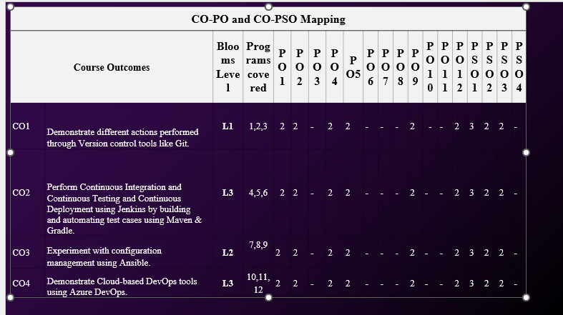
)
24

Slide 25
Assessment Details (both CIE and SEE)
25
The weightage of Continuous Internal Evaluation (CIE) is 50% and for Semester End Exam (SEE) is 50%.
The minimum passing mark for the CIE is 40% of the maximum marks (20 marks out of 50) and for the SEE minimum passing mark is 35% of the maximum marks (18 out of 50 marks).
A student shall be deemed to have satisfied the academic requirements and earned the credits allotted to each subject/course if the student secures a minimum of 40% (40 marks out of 100) in the sum total of the CIE(Continuous Internal Evaluation) and SEE (Semester End Examination) taken together

Slide 26
Continuous Internal Evaluation (CIE)
26
CIE marks for the practical course are 50 Marks.
The split-up of CIE marks for record/ journal and test are in the ratio 60:40.
● Each experiment is to be evaluated for conduction with an observation sheet and record write-up.
● Record should contain all the specified experiments in the syllabus and each experiment
write-up will be evaluated for 10 marks.
● Total marks scored by the students are scaled down to 30 marks (60% of maximum marks).
● Weightage to be given for neatness and submission of record/write-up on time.
● Department shall conduct a test of 100 marks after the completion of all the experiments
listed in the syllabus.
● In a test, test write-up, conduction of experiment, acceptable result, and procedural knowledge will carry a weightage of 60% and the rest 40% for viva-voce.
● The suitable rubrics can be designed to evaluate each student’s performance and learningability.
● The marks scored shall be scaled down to 20 marks (40% of the maximum marks).
The Sum of scaled-down marks scored in the report write-up/journal and marks of a test is the
total CIE marks scored by the student.

Slide 27
Continuous Internal Evaluation (CIE)
27
CIE marks for the practical course are 50 Marks.
The split-up of CIE marks for record/ journal and test are in the ratio 60:40.
● Each experiment is to be evaluated for conduction with an observation sheet and record write-up.
● Record should contain all the specified experiments in the syllabus and each experiment
write-up will be evaluated for 10 marks.
● Total marks scored by the students are scaled down to 30 marks (60% of maximum marks).
● Weightage to be given for neatness and submission of record/write-up on time.
● Department shall conduct a test of 100 marks after the completion of all the experiments
listed in the syllabus.
● In a test, test write-up, conduction of experiment, acceptable result, and procedural knowledge will carry a weightage of 60% and the rest 40% for viva-voce.
● The suitable rubrics can be designed to evaluate each student’s performance and learningability.
● The marks scored shall be scaled down to 20 marks (40% of the maximum marks).
The Sum of scaled-down marks scored in the report write-up/journal and marks of a test is the
total CIE marks scored by the student.

Slide 28


Prerequisite for the course
Basic computer knowledge
Understanding of Operating Systems (Linux basics preferred)
Basic networking concepts (IP, ports, protocols)
Basic programming or scripting (Python / Shell is enough)
Knowledge of software development basics (how code is written and tested)
Note:-Basic knowledge of Linux, networking, programming, and software development is required for a DevOps course.
Attend labs , avoid being sad and stay happy

Slide 29

Students' perspective
29
Students introducing themselves
Expectations – Questions

Slide 30
Expected Lab behaviour
30
Be on time – servers don’t wait 😏
Read the experiment first – panic later not allowed
Follow instructions – creativity is for projects, not labs
No copy-paste without understanding (Git remembers 👀)
Handle systems carefully – break code, not machines
Maintain silence & teamwork – chaos breaks pipelines
Submit on time – CI/CD has no mercy
No discipline → Failed build → Lab repeat 😄

Slide 31
Some useful links
31
Suggested Learning Resources:
● https://www.geeksforgeeks.org/devops-tutorial/
● https://www.javatpoint.com/devops
● https://www.youtube.com/watch?v=2N-59wUIPVI
● https://www.youtube.com/watch?v=87ZqwoFeO88

Slide 32
32
Thank You

